Slide 1
Lock based protocol

Slide 2
A lock is kind of a mechanism that ensures that the integrity of data is maintained.
It does that, by locking the data while a transaction is running, any transaction cannot read or write the data until it acquires the appropriate lock.
There are two types of a lock that can be placed while accessing the data so that the concurrent transaction can not alter the data while we are processing it.
Shared Lock(S)
Exclusive Lock(X)

Slide 3
Shared Lock (S): also known as Read-only lock.
As the name suggests it can be shared between transactions because while holding this lock the transaction does not have the permission to update data on the data item.
S-lock is requested using lock-S instruction.
2.Exclusive Lock (X): Data item can be both read as well as written.
This is Exclusive and cannot be held simultaneously on the same data item.
X-lock is requested using lock-X instruction.

Slide 4
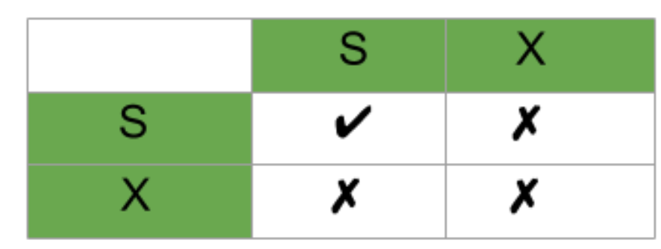
Lock Compatibility Matrix –
A transaction may be granted a lock on an item if the requested lock is compatible with locks already held on the item by other transactions.
Any number of transactions can hold shared locks on an item, but if any transaction holds an exclusive(X) on the item no other transaction may hold any lock on the item.
If a lock cannot be granted, the requesting transaction is made to wait till all incompatible locks held by other transactions have been released. Then the lock is granted.

Slide 5
There are four types of lock protocols available:
1. Simplistic lock protocol
It is the simplest way of locking the data while transaction.
Simplistic lock-based protocols allow all the transactions to get the lock on the data before insert or delete or update on it.
It will unlock the data item after completing the transaction.

Slide 6
2. Pre-claiming Lock Protocol
Pre-claiming Lock Protocols evaluate the transaction to list all the data items on which they need locks.
Before initiating an execution of the transaction, it requests DBMS for all the lock on all those data items.
If all the locks are granted then this protocol allows the transaction to begin. When the transaction is completed then it releases all the lock.
If all the locks are not granted then this protocol allows the transaction to rolls back and waits until all the locks are granted.

Slide 7
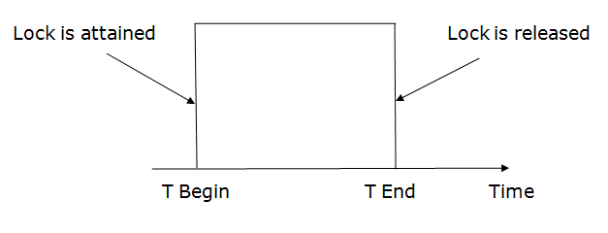

Slide 8
3. Two-phase locking (2PL)
The two-phase locking protocol divides the execution phase of the transaction into three parts.
In the first part, when the execution of the transaction starts, it seeks permission for the lock it requires.
In the second part, the transaction acquires all the locks. The third phase is started as soon as the transaction releases its first lock.
In the third phase, the transaction cannot demand any new locks. It only releases the acquired locks

Slide 9
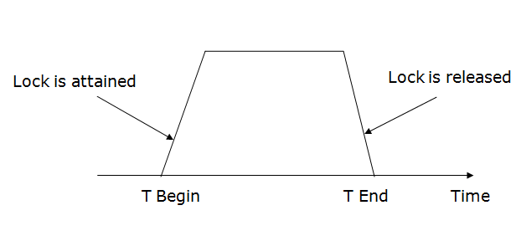

Slide 10
There are two phases of 2PL:
Growing phase: In the growing phase, a new lock on the data item may be acquired by the transaction, but none can be released.
Shrinking phase: In the shrinking phase, existing lock held by the transaction may be released, but no new locks can be acquired.
In the below example, if lock conversion is allowed then the following phase can happen:
Upgrading of lock (from S(a) to X (a)) is allowed in growing phase.
Downgrading of lock (from X(a) to S(a)) must be done in shrinking phase.
Example:

Slide 11
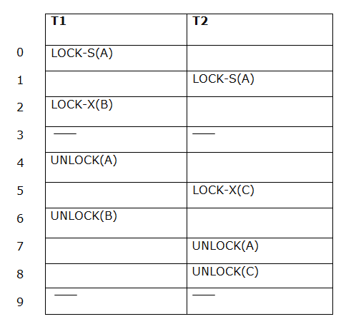
The following way shows how unlocking and locking work with 2-PL.
Transaction T1:
Growing phase: from step 1-3
Shrinking phase: from step 5-7
Lock point: at 3
Transaction T2:
Growing phase: from step 2-6
Shrinking phase: from step 8-9
Lock point: at 6

Slide 12
Strict Two-phase locking (Strict-2PL):
The first phase of Strict-2PL is similar to 2PL. In the first phase, after acquiring all the locks, the transaction continues to execute normally.
The only difference between 2PL and strict 2PL is that Strict-2PL does not release a lock after using it.
Strict-2PL waits until the whole transaction to commit, and then it releases all the locks at a time.
Strict-2PL protocol does not have shrinking phase of lock release.

Slide 13
